Slide 1
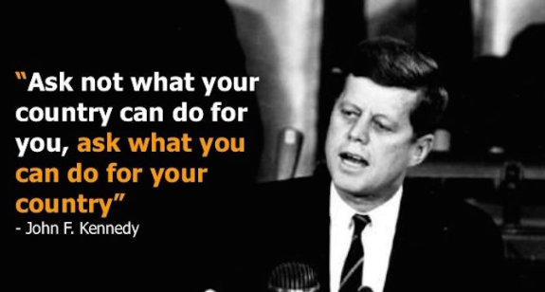

Slide 2


Slide 3
Student Leadership

Slide 4
Why be a leader?
Develop essential skills for future careers
Improve your confidence and self belief
Take responsibility for supporting, improving and the benefit of others.
Learn about yourself, your psychology, how you react and manage situations.
One of the most rewarding things you can do is help others to achieve.

Slide 5
Student Leadership roles
Please note:
Not all applicants will be given interviews.
Not all interviewed will be offered roles.
Roles for KS4 students:
  2 Head students
  1 Chair of School Council (Deputy Head student)
  4 House captains – Y10 roles
  Senior Prefects e.g.
    Reading Mentor programme
    Student voice
    Events, clubs and organisational aspects
  A number of prefect roles (numbers and roles dependant on the cohort – may be subject specific roles) – May also be offered to Y10s
  All roles carry expectations of additional time, some of this will be after school

Slide 6
Application process
In order to be considered you will be required to apply for the role(s) you wish to undertake.
Should you apply for a higher role you will be automatically considered for the other roles if you are unsuccessful.
Decide that you are interested in applying for one of the many roles
Look at what the role entails. What skills do you have that are suited to the role? Use your PEP booklets to support you
Complete the online application form including why you feel you should be given the role you are applying for.
Submit your finished application
If selected for interview, undertake the interview for the position you applied for

Slide 7
Prefects
The role of a prefect varies from year to year and is dependent on the skillset of the cohort. In general, the prefects will contribute to the running of events as well as some responsibilities in breaks, lunchtimes or after school.
Possible roles of prefects:
Transition events
Supporting lower school students in specific subjects
A role with tours
Mentoring lower school students or supporting them with aspects like reading.
Specialising in a set subject, support the subject with clubs and/or competitions

Slide 8
Senior Prefect
This role carries various responsibilities. The role of a Senior prefect varies from year to year however, you will be issued an area of responsibility similar to the below areas. This will be an area you are expected to lead on and ensure its impact. As a leader of a team of prefects, it will be your responsibility to coordinate the role with relevant staff.
Possible roles of the senior prefect:
Reading Mentor lead (support training and QA of the process)
Student Voice
Events, clubs and duties
House system
You will all be involved in;
Transition events
Supporting lower school students in specific subjects or areas
A role with tours
Staff Interview process

Slide 9
Chair of School Council (Deputy Head Student)
The deputy head student will carry out the roles of the Head student in their absence. As the Deputy Head student, you will take a leading role in the school council and student wellbeing.
Deputy Head students will play an active role in:
Transition events, Presentation evenings and Options evenings
Lead on the school council meetings reporting back to the school
Support in school events
Support Head students in their school community project (Student led)
Be a role model to all students

Slide 10
Head Student
A Head student should be a role model for the entire school community. This is a role for a student with the confidence to speak to others and, for others. You should be an example both in and out of the class.
Head students will play an active role in:
Transition events, Presentation evenings and Options evenings, often giving a speech.
Support the Deputy Head Student in the leading of the school council meetings
Support in most school events including other students parents evenings.
Undertake a school legacy project (Student led)
Support in celebration assemblies
Part of the Staff Interview process
Set an example as a role model to all students in the school

Slide 11
Letter of application/personal statement
Your personal statement is instrumental in securing an interview for any role. It is important that you sell your skills and qualities. The PEP folder is a superb way to start this off.
Include:
What role you are applying for ideally (Nb: You will be considered for all roles in the team irrespective of the one you apply for)
Explain why you feel you are suitable for the role and what skills you will bring to the role
Explain how your skills make you suitable for the role.
What have you done in school and outside to demonstrate why you should be considered.
For Head student roles you will require a presentation of your planned school community legacy project. This must be an achievable aspect that you can accomplish in 6 months of being appointed. Your presentation should include details about how you would be able to facilitate this and expected, measurable outcomes.

Slide 12
Interview process
You will be interviewed for the role, this will be in a formal setting, it is good preparation for your future Post-16 and job applications.
The interview will Include:
Questions around your application
Why you feel you are suitable for the role you applied for
What contributions you have made to the school so far and how you will develop that in the role
How you will be seen by others
How you see this role supporting you and your goals
Other suitable questions related to the skills and qualities required for the role.

Slide 13
Y10 role - House Captains (Y9)
The House captains will take a leading role in the running of all house events across the school curriculum and year groups.
House captains will play an active role in:
Transition events
Support in all house events including, sport, subject events and all other house related competitions
Present house related rewards in assembly (Speaking is not required!)
You need to have an enjoyment of healthy competition and lead others in respectful behaviours around this.

