Slide 1


Supporting your child through their GCSEs

Slide 2
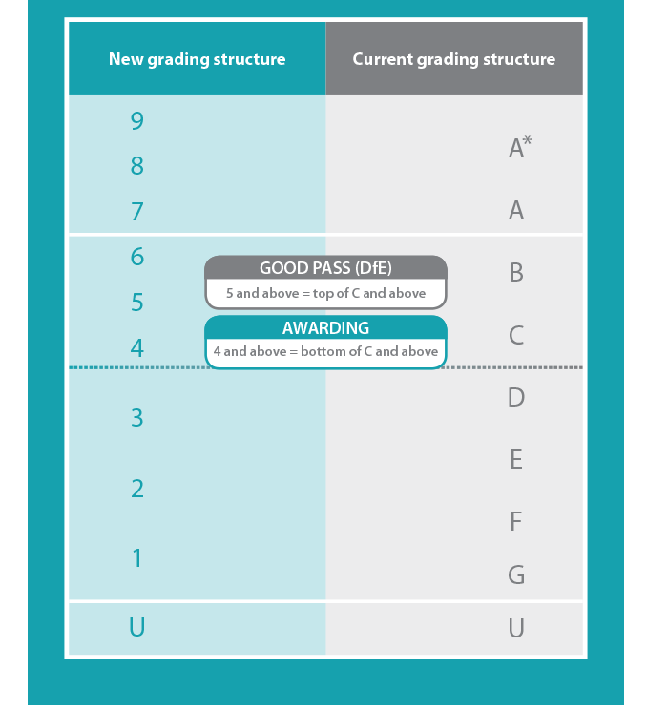
Letters to numbers
Old

Slide 3
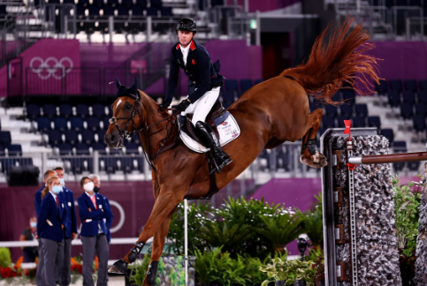


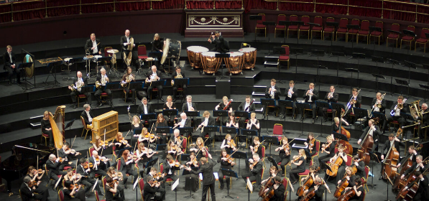
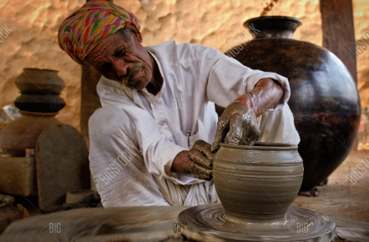
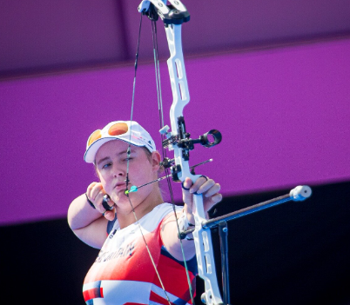
What links these together?

Slide 4
What links these together?
It takes considerable practice to become as fluent in all these skills as the people in the image. It does not happen by chance!
Revision is another word for practice.

Slide 5
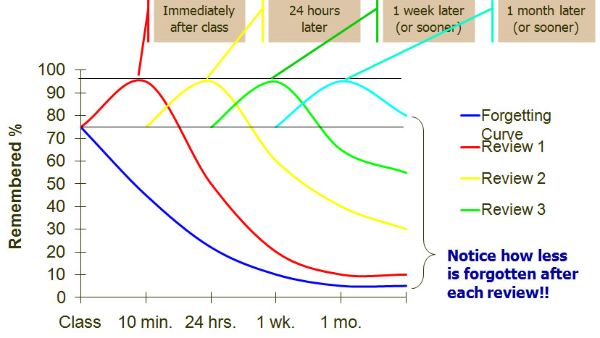
Ebbinghaus Curve

Slide 6
Building Schemata.

Slide 7

Workspace
Fully equipped to prevent procrastination
Interruption free for concentration – phone?
Specific area just for them to work in or designated time slots etc.
All notes, resources required easily to hand.

Slide 8
Attendance
Significant impact on outcomes:
  Only 12% of pupils with below 80% school attendance achieve five or more GCSEs at grades 9 to 4 including English and Maths​
  Compared to 68% for pupils with attendance greater than 95%.

Slide 9

Attitude

Slide 10
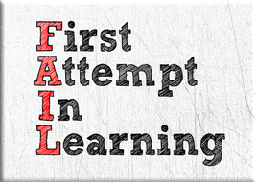
Fear of Failure
Riding a bike, walking, talking, reading, writing, kicking a ball etc
Learning often requires failure
  Support resilience
  Reassure its normal and learning is often challenging
  Sometimes, you have to put it down and come back to it
  Try different ways around the problem
  Discussion is a useful aid
YET!
Notes:
Fear of failure
Supporting them with positive/growth mindsets – I didn’t get the grade – YET
You will, you can , you have to try again.

Slide 11
Alphabet Challenge
30 seconds to work out:
  Letters:
    8
    5
    12
    16
    21
    19

Slide 12
Alphabet Challenge
  Letters:
    8 H
    5 E
    12 L
    16 p
    21 U
    19 S
Name that tune?

Slide 13
Mindmaps and Brainstorms
Early challenges to the Weimar Republic
  Create a bubble in the middle with the title
  Add the key blocks of information around the bubble
    Treaty of Versailles (1919)
    French invasion of the Ruhr (1923)
    Political assassinations (various)
    Hyperinflation (1924)
    Spartacist uprising (1919)
    Kapp Putsch (1920)
    Munich Putsch (1923)

Slide 14
Mindmaps and Brainstorms
Change the format
For each, add a little detail about the event (Y11 History students – no pressure!!!)
Add links between them – along the line, why does one event cause/contribute to the other?
Revision 2 – expand the information about each event to include a narrative.
Revision 3 – Answer an exam question using the details e.g. explain why their were early challenges for the Weimar Republic.

Slide 15
The rule of three (triangulate)
Revision 1 – Create the mind map/diagram and details.
Revision 2 – Expand the information about each event to include a narrative of the events.
Revision 3 – Answer an exam question using the details e.g. explain why their were early challenges for the Weimar Republic.

Slide 16
The rule of three (triangulate)
Revision 1 – Create the revision cards
Revision 2 – Work with a partner to ask questions and answer them verbally
Revision 3 – Look at the question and write a full answer in continuous prose.

Slide 17
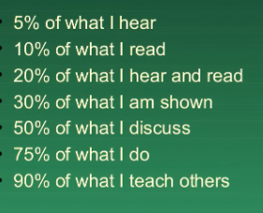
Oracy
The ability to explain to another person the topic and your understanding of it.
Discuss topics with you
Change the format of information
Teach parents/siblings/friends what you know

Slide 18
Homework
But mum, I have no homework…
Seneca
Revision guides
Reading
Explain to someone else what you know about X,Y or Z
GCSE Bitesize
Flashcards
Youtube
Change the format of your notes
Summarise

Slide 19
Downtime and Burnout
Plan your revision time to include breaks
20 min stints
Rewards built in to your schedules
ESSENTIAL for all students
  Downtime/recreation

Slide 20
In Summary
Take an interest in their studies
Ask to look at books (including review windows)
Organise a work space for them to study at home
Assist them with extension work / homework
Discuss their reports with them
Plan a revision timetable
Help them to set ambitious yet realistic targets
Encourage them to have a healthy lifestyle
Do contact the School if there is a problem

